Slide 1
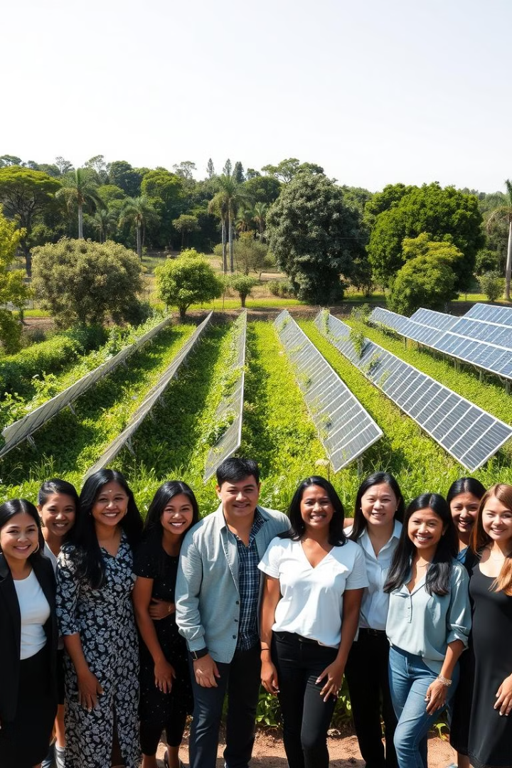
E-Commerce for Artisans
Presented By:
Nikhil Garg 2100290120113
Prakhar Sharma 2100290120123
Navneet Saini 2100290120111
Diwakar Mittal 2100290120075
Project Guide: Dr. Harsh Khatter

Slide 2
Ensure fair pricing and profits.
Preserve traditional crafts.
Provide a user-friendly platform.
Support sustainable development.
Project Abstract
Overview
Key Objectives
Approach
Build a user-friendly online marketplace.
Onboard artisans with minimal tech requirements.
Implement secure payment
Promote the platform to reach global customers.
The E-commerce for Artisans project is an online platform that helps artisans reach a wider market, sell their products directly to customers, and earn fair profits, while promoting cultural preservation and sustainable growth.

Slide 3

Project Goals and Objectives
Expand Artisan Market Reach
1
Connect artisans with a global audience to increase sales and visibility.
2
Ensure Fair Pricing
Enable artisans to set fair prices, reducing reliance on intermediaries for better earnings.
Preserve Cultural Heritage
3
Promote traditional crafts, supporting artisans in sustaining their cultural and artistic practices.

Slide 4

Alignment with UN Sustainable Development Goals (SDGs)
SDG 1: No Poverty
SDG 8: Decent Work
and Economic Growth
Helps artisans increase their income, reducing poverty among small-scale producers
Promoting inclusive and sustainable economic growth.
SDG 12: Responsible Consumption and Production
SDG 10: Reduced
Inequalities
Promoting handmade, sustainable products and supporting local artisans instead of mass-produced goods
Promotes equal opportunities and helps reduce economic disparities

Slide 5





Methodology and Approach
Platform Development
Design and develop a user-friendly e-commerce platform that allows artisans to easily list and sell their products, with secure payment options and a straightforward interface.
Artisan Onboarding
Help artisans with minimal technical knowledge adapt to digital sales, covering areas like product photography, pricing, and customer service.
Marketing and Outreach
Promote the platform through digital marketing and partnerships, targeting both local and international customers interested in authentic, handcrafted products.
Payment Solutions
Establish payment systems, enabling smooth product delivery and secure transactions, making it easy for artisans to reach customers without geographical limitations.

Slide 6




Expected Outcomes and Impact
Increased Income for Artisans
Cultural Preservation
Sustainable Economic Growth
Artisans benefit from higher sales and fairer profits, leading to improved livelihoods and financial independence
Traditional crafts gain renewed value and visibility, helping to sustain cultural heritage and artisan skills for future generations.
The platform fosters local economic development and promotes ethical, sustainable consumer behavior, contributing to long-term, responsible growth.

Slide 7

Key Project Deliverables & Future Scope
E-commerce Platform
Fully functional online marketplace tailored for artisans
Quality Materials to Consumer
high-standard resources used in products or projects to ensure durability, efficiency, and reliability.
Marketing Strategy and Campaigns
(for Artisans)
Promotional content to attract customers and boost platform visibility

Slide 8

Next Steps and Conclusion
1
Scale and Expand
2
Forge Partnerships
Replicate the successful model in other regions and continue to grow the project's impact.
Collaborate with government, private sector, and civil society to further strengthen the initiative.
3
Monitor and Evaluate
Continuously assess the project's performance and make adjustments to optimize its effectiveness.

Slide 9
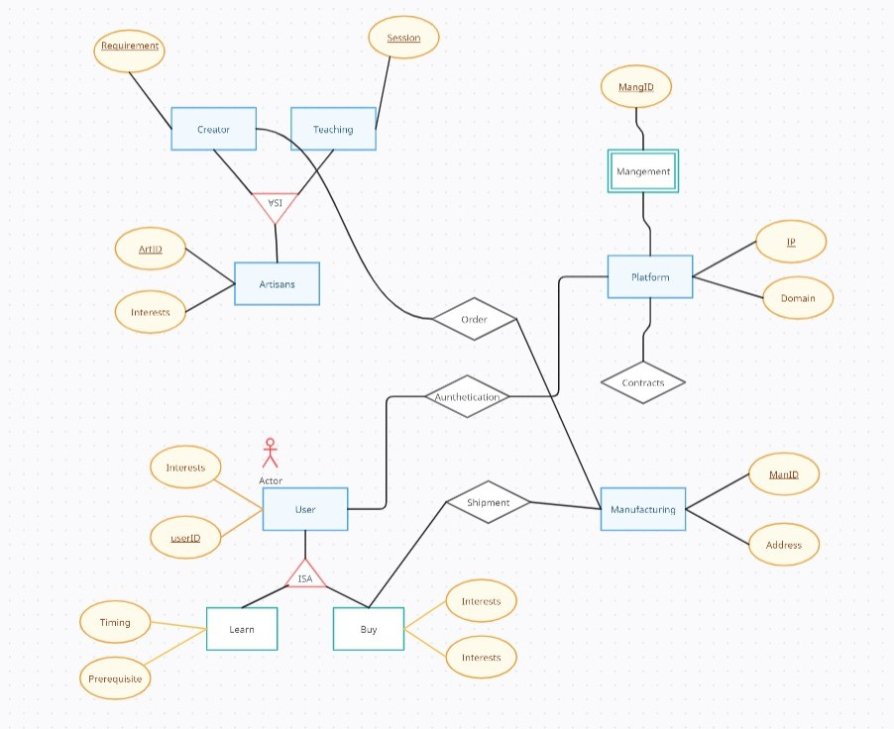
ER DIAGRAM

Slide 10
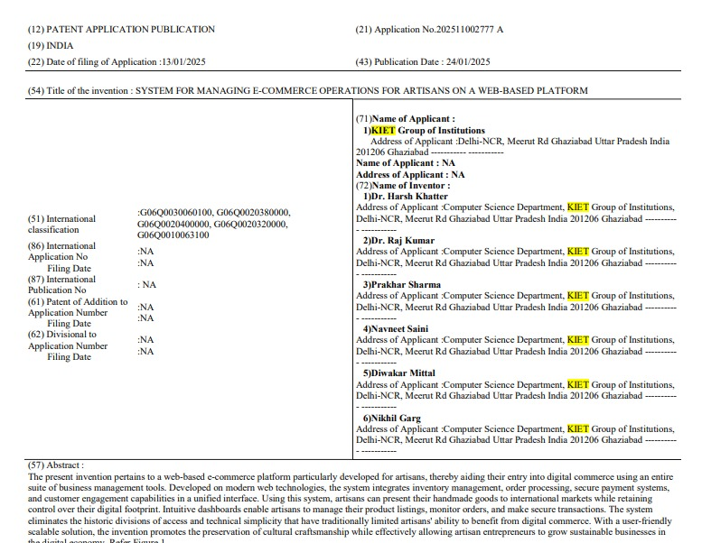
Patent Status

Slide 11
THANK YOU

